Slide 1
Winter Socials
Games Group

Slide 2
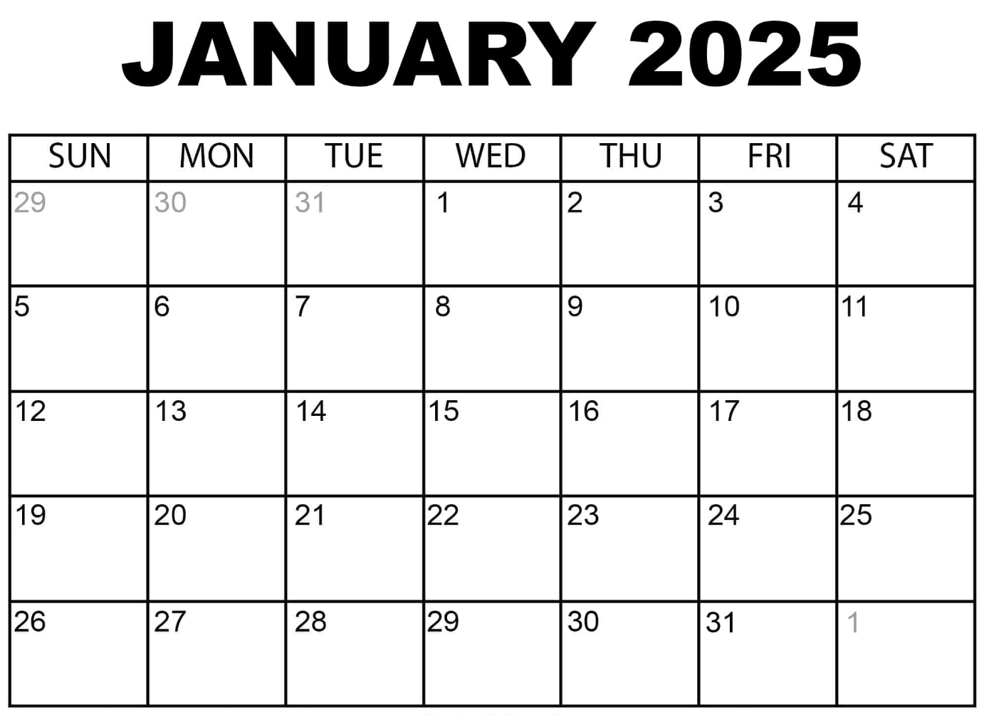
Hosted by Simran
Hosted by Gustavo
Powergrid
6 ppl
Hosted by Reza
HP Codenames, homemade pizza, 6ppl
Hosted by Emilio
Hosted by Laurino
AASA Xover, 20 ppl, Asian Snacks
Hosted by Jesse
Mario,
8 ppl

Slide 3
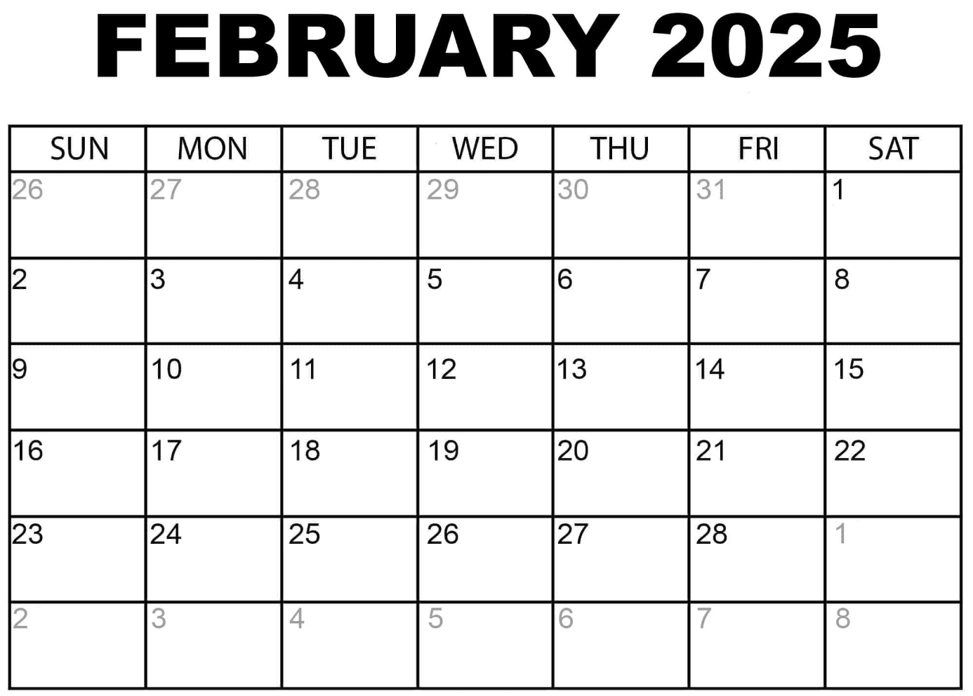
Hosted by Simran
Mario,
8 ppl
Hosted by Gustavo
Avalon
10 ppl
Hosted by Reza
TBD
10 ppl
Hosted by Emilio
Party Games
20 ppl
Hosted by Laurino
Light Strategy
10 ppl
Hosted by Jesse
Puzzles,
12 ppl

Slide 4
Escape Rooms - Winter 2025 - Organized by Simran
Date/Times Winter Quarter:
Thursday 1/16 1:40pm - Mysterious Market (5 people)
Friday 1/17 11:00am - Prison Break (4 people)
Friday 1/17 11:00am - Mysterious Market (4 people)
Friday 1/17 11:20am - The Heist (4 people)
Official Ratings:
Gold Rush = 7/10 difficulty
Mysterious Market, The Heist, Mission Mars** = 8/10 difficulty
Prison Break = 9/10 difficulty
** Mission Mars felt easier – like a 6 or 7 out of 10; Mysterious Market felt harder (9/10)

Slide 5
Activate - Winter 2025 - Led by Simran
https://playactivate.com/
13 people per reservation
$25/person – charge $15 for members

Slide 6
Appendix

Slide 7
Small Group Game Nights
Setup weekly game nights, $30-40 budget for snacks for groups up to 10 ppl
No alcohol (different rules/forms/etc. through student life)
For groups bigger than 10, snack budget to be increased to $50-60
All weekly game nights will mention the game(s) or types of games that will be played
Offer variety of game types/games and also have a few video game nights per quarter
Offer game nights different nights of the week (not just one day)
Each games co-chair will host at least one
At least one event per week (can skip small group game night the weeks we have larger events if needed)
Food & Drinks
Variety & Accessibility
Co-Chair Duties

Slide 8
Escape Rooms
The Escape Game contact:
Caro Scarbrough: Caro.Scarbrough@theescapegame.com
Historically given rates of $26/person during weekdays before 5pm
  charge $15 for members, $30 for non-members
6 people to reserve a room but we’ve been able to get away with booking fewer per room and taking the risk no one else will book because they’re odd times

